Slide 1
Data Warehousing
Data warehousing is the process of collecting, integrating, storing and managing data from multiple sources in a central repository.
It enables organizations to organize large volumes of current and historical data for efficient querying, analysis and reporting.
The main goal of data warehousing is to support decision-making by providing clean, consistent and timely access to data. It ensures fast data retrieval even when working with massive datasets.

Slide 2
Need for Data Warehousing
Handling Large Data Volumes: Traditional databases store limited data (MBs to GBs), while data warehouses are built to handle huge datasets (up to TBs), making it easier to store and analyze long-term historical data.
Enhanced Analytics: Databases handle transactions; data warehouses are optimized for complex analysis and historical insights.
Centralized Data Storage: A data warehouse combines data from multiple sources, giving a single, unified view for better decision-making.
Trend Analysis: By storing historical data, a data warehouse allows businesses to analyze trends over time, enabling them to make strategic decisions based on past performance and predict future outcomes.
Business Intelligence Support: Data warehouses work with BI tools to give quick access to insights, helping in data-driven decisions and improving efficiency.

Slide 3
Components
Data Sources: These are the various operational systems, databases and external data feeds that provide raw data to be stored in the warehouse.
ETL (Extract, Transform, Load) Process: The ETL process is responsible for extracting data from different sources, transforming it into a suitable format and loading it into the data warehouse.
Data Warehouse Database: This is the central repository where cleaned and transformed data is stored. It is typically organized in a multidimensional format for efficient querying and reporting.
Metadata: Metadata describes the structure, source and usage of data within the warehouse, making it easier for users and systems to understand and work with the data.

Slide 4
Components
Data Marts: These are smaller, more focused data repositories derived from the data warehouse, designed to meet the needs of specific business departments or functions.
OLAP (Online Analytical Processing) Tools: OLAP tools allow users to analyze data in multiple dimensions, providing deeper insights and supporting complex analytical queries.
End-User Access Tools: These are reporting and analysis tools, such as dashboards or Business Intelligence (BI) tools, that enable business users to query the data warehouse and generate reports.

Slide 5
Real world Example of Data warehousing
Data Warehousing can be applied anywhere where we have a huge amount of data and we want to see statistical results that help in decision making.
1. E-commerce
Data Gathering: Orders, returns, payments, user clicks, delivery updates.
Schema: Combines source data into a structured star schema for analysis.
Cleansing: Standardizes customer names, locations and product categories.
Updates: Near real-time or scheduled loads for fresh insights.
Summarization: Bestsellers by category, regional demand trends, logistics performance.

Slide 6
Banking
Data Gathering: ATM transactions, online banking, credit card usage, loan records.
Schema: Integrates data from core banking, CRM and fraud detection systems.
Cleansing: Fixes inconsistencies in account info, transaction logs and addresses.
Updates: Transaction data is batched and uploaded nightly.
Summarization: Daily cash flow reports, high-risk account flags and customer profitability analysis.

Slide 7
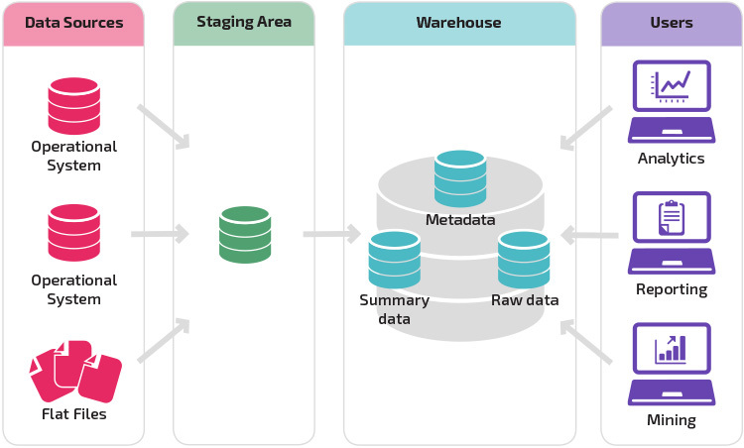
Data Warehouse Architecture
ETL

Slide 8
ETL Process

Slide 9
What is ETL?
Extract
Transform
Load
Data Sources
Staging Area
Data Warehouse

Slide 10
What is ETL?
Extraction, Transform and Load
Data Extraction
Extraction of data from the source systems.
Data Transformation
Includes all the functions and procedures for changing the source data into the exact formats and structures appropriate for storage in the data warehouse database
Loading Data
Physically moves the data into the data warehouse repository.

Slide 11
Steps in ETL
1. Determine all the target data needed in the data warehouse.
2. Determine all the data sources, both internal and external.
3. Prepare data mapping for target data elements from sources.
4. Establish comprehensive data extraction rules.
5. Determine data transformation and cleansing rules.
6. Plan for aggregate tables.
7. Organize data staging area and test tools.
8. Write procedures for all data loads.
9. ETL for dimension tables.
10. ETL for fact tables.

Slide 12
ETL Key Factors
Complexity of data extraction and transformation
Reason: the tremendous diversity of the source systems.
Need to pay special attention to the various sources and begin with a complete inventory of the source systems.
The difficulties encountered in the data transformation function also relate to the heterogeneity of the source systems.
Data Loading Functions
Find the proper time to schedule full refreshes.
Determine the best method to capture the ongoing changes from each source system
Execute the capture without impacting the source systems.
Schedule the incremental loads without impacting use of the data warehouse by the users

Slide 13
Data Extraction

Slide 14
Data Extraction
Data extraction for a data warehouse
you have to extract data from many different sources
you have to extract data on the changes for ongoing incremental loads as well as for a one-time initial full load.
Two factors increase the complexity of data extraction for a data warehouse.
What are the Data Extraction issues??
Source identification
Method of extraction
extraction frequency
Time window
Job sequencing
Exception handling

Slide 15
Data Extraction
Source Identification
It encompasses the identification of all the proper data sources
It include examination and verification that the identified sources will provide the necessary value to the data warehouse

Slide 16
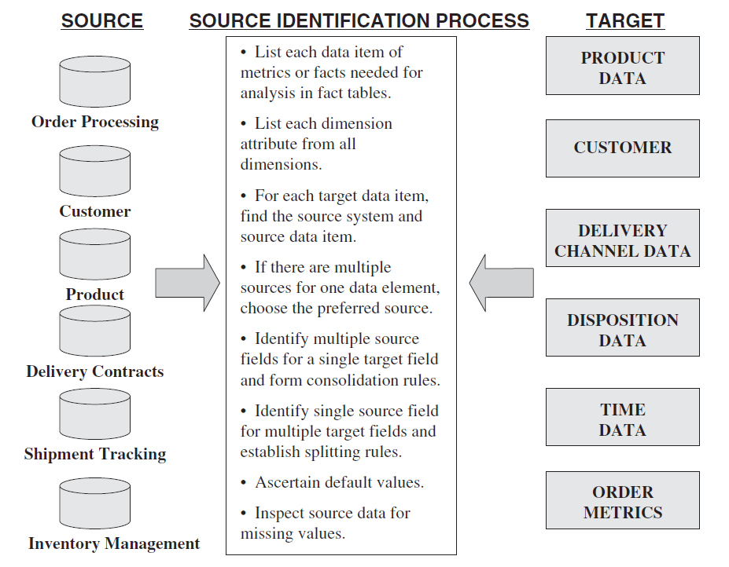

Slide 17
Data Extraction Techniques
Data in Operational Systems
Operational data in the source system falls into two broad categories.
The type of data extraction technique you have to use depends on the nature of each of these two categories.
Current Value
The stored value of an attribute represents the value of the attribute at this moment of time.
The values are transient or transitory.
There is no way to predict how long the present value will stay or when it will get changed next.
Data extraction for preserving the history of the changes in the data warehouse gets quite involved for this category of data.

Slide 18
Data Extraction Techniques
Data in Operational Systems
Periodic Status
The value of the attribute is preserved as the status every time a change occurs.
At each of these points in time, the status value is stored with reference to the time when the new value became effective.
The history of the changes is preserved in the source systems themselves.
Therefore, data extraction for the purpose of keeping history in the data warehouse is relatively easier.

Slide 19
Data Extraction Techniques
Initial load
Two major types of data extractions from the source operational systems:
“As is” (static) Data Extraction
Data Extraction of Revisions

Slide 20
Data Extraction Techniques
“As is” (static) data extraction
The capture of data at a given point in time.
Taking snapshot of relevant source data at certain point in time
Primarily used for initial load of data warehouse
This data capture would include each status or event at each point in time as available in the source operational systems.

Slide 21
Data Extraction Techniques
Data of revision
Also called as incremental data capture
Not strictly incremental data but the revisions since the last time data was captured
If the source data is transient, the capture of the revisions is not easy.
For periodic status data or periodic event data, extracts the statuses and events that have been recorded since the last data extraction.
Incremental data capture may be immediate or deferred.

Slide 22
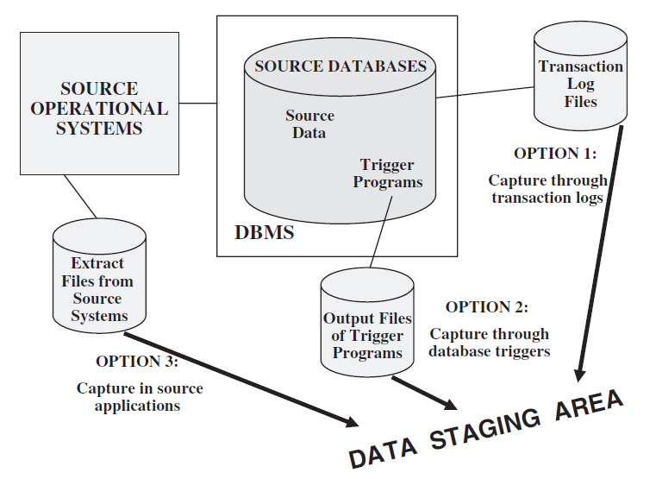
Data Extraction Techniques
Data of revision
Immediate Data Extraction
The data extraction is real-time.
Three options for immediate data extraction
Capture through transaction logs
Capture through database triggers
Capture in source applications

Slide 23
Data Extraction Techniques
Data of revision
Immediate Data Extraction: Capture through transaction logs
Uses the transaction logs of the DBMSs maintained for recovery from possible failures.
As each transaction adds, updates, or deletes a row from a database table, the DBMS immediately writes entries on the log file.
This data extraction technique reads the transaction log and selects all the committed transactions.
Make sure that all transactions are extracted before the log file gets refreshed
If source system data is on indexed and other flat files, this option will not work for these cases.

Slide 24
Data Extraction Techniques
Data of revision
Immediate Data Extraction: Capture through Database Triggers
Create trigger programs for all events for which you need data to be captured.
The output of the trigger programs is written to a separate file that will be used to extract data for the data warehouse.
Data capture through database triggers occurs right at the source and is therefore quite reliable.
You can capture both before and after images.
Building and maintaining trigger programs puts an additional burden on the development effort.
Applicable only for source data in databases.

Slide 25
Data Extraction Techniques
Data of revision
Immediate Data Extraction: Capture through Source Applications
Also referred to as application assisted data capture.
The source application is made to assist in the data capture for the data warehouse.
Revise the programs to write all adds, updates, and deletes to the source files and database tables.
Other extract programs can use the separate file containing the changes to the source data.
Applicable for all types of source data irrespective of whether it is in databases, indexed files, or other flat files.
May degrade the performance of the source applications because of the additional processing needed to capture the changes on separate files.

Slide 26
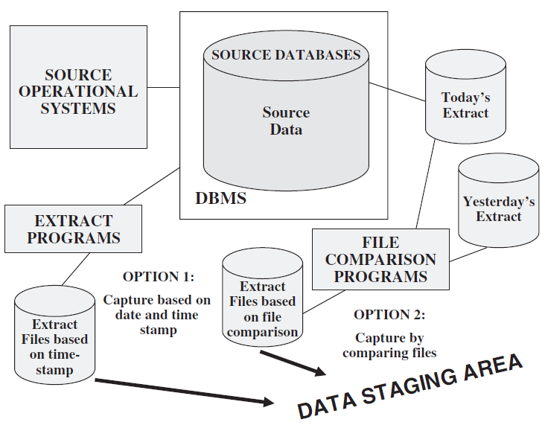
Data Extraction Techniques
Data of revision
Deferred Data Extraction:
Do not capture the changes in real time.
The capture happens later.
Two options
Capture based on date and time stamp
Capture by comparing files

Slide 27
Data Extraction Techniques
Data of revision
Deferred Data Extraction: Capture based on date and time stamp
Every time a source record is created or updated it may be marked with a stamp showing the date and time.
The time stamp provides the basis for selecting records for data extraction.
This technique works well if the number of revised records is small.
Data capture based on date and time stamp can work for any type of source file.
It captures the latest state of the source data.
Any intermediary states between two data extraction runs are lost.
Deletion of source records presents a special problem.
Mark the source record for delete, do the extraction run, and then physically delete the record

Slide 28
Data Extraction Techniques
Data of revision
Deferred Data Extraction: Capture by Comparing Files
Also called the snapshot differential technique,
Do a full file comparison between today’s copy of the data and yesterday’s copy.
Compare the record keys to find the inserts and deletes.
Capture any changes between the two copies.
Requires to keep the prior copies of all the relevant source data.
Though simple and straightforward, comparison of full rows in a large file can be very inefficient.

Slide 29
Data Extraction Techniques
Capture of static data
Capture through transaction log
Capture through database triggers
Capture in source applications
Capture based on date and time stamp
Capture by comparing files

Slide 30
Data Transformation

Slide 31
Data Transformation
The extracted data must be made usable in the data warehouse.
We have to enrich and improve the quality of the data before it can be usable in the data warehouse.
Basic Tasks in Data Transformation
Selection
Select either whole records or parts of several records from the source systems.
Splitting / Joining
Splitting the selected parts even further during data transformation.
Joining of parts selected from many source systems is more widespread in the data warehouse environment.

Slide 32
Data Transformation
Basic Tasks in Data Transformation
Conversion
Includes fundamental conversions of single fields for two primary reasons
To standardize among the data extractions from disparate source systems,
To make the fields usable and understandable to the users.
Summarization
Summarizing data at different level of granularities
Enrichment
The rearrangement and simplification of individual fields to make them more useful for the data warehouse environment

Slide 33
Data Transformation
Major Transformation Types / Transformation Functions
Format Revisions
Includes changes to the data types and lengths of individual fields.
It is wise to standardize and change the data type to text to provide values meaningful to the users.
Decoding of fields
You are bound to have the same data items described by a plethora of field values.
E.g. codes used for recording gender information
You need to decode all such cryptic codes and change these into values that make sense to the users.

Slide 34
Data Transformation
Major Transformation Types / Transformation Functions
Calculated and Derived values:
e.g The sales system contains sales amounts, sales units, and operating cost estimates by product.
You will have to calculate the total cost and the profit margin before data can be stored in the data warehouse
Splitting of single field
By splitting the fields
You may improve the operating performance by indexing on individual components.
Users may need to perform analysis by using individual components
E.g address of an employee or customers

Slide 35
Data Transformation
Major Transformation Types / Transformation Functions
Merging of Information:
Merging of information denotes the combination of the different fields from different sources into a single entity.
Character set conversion
The conversion of character sets to an agreed standard character set for textual data in the data warehouse.
Conversion of Units of Measurements
You may have to convert the metrics so that the numbers are all in one standard unit of measurement.
E.g. currency

Slide 36
Data Transformation
Major Transformation Types / Transformation Functions
Date/Time Conversion:
Representation of date and time in standard formats.
Summarization:
The creation of summaries to be loaded in the data warehouse instead of loading the most granular level of data.
Deduplication
Keeping a single record for one customer and link all the duplicates in the source systems to this single record.

Slide 37
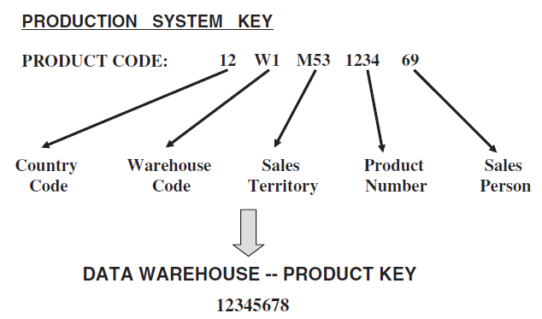
Data Transformation
Major Transformation Types / Transformation Functions
Key Restructuring
Transform primary keys of extracted records into generic keys generated by the system itself.

Slide 38
Data Transformation
Data Integration and Consolidation
The real challenge of ETL functions is the pulling together of all the source data from many disparate, dissimilar source systems.
Integrating the data involves combining all the relevant operational data into coherent data structures to be made ready for loading into the data warehouse.
Standardize the names and data representations and resolve discrepancies in the ways in which the same data is represented in different source systems.
Data integration and consolidation is a type of preprocessing before any data transformation

Slide 39
Data Transformation
Data Integration and Consolidation
Entity Identification Problem
e. g. Three different legacy applications have three different customer files supporting those systems.
The same customer on each of the files may have a unique identification number which may not be the same across the three systems.
In this case, you do not know which of the customer records relate to the same customer.
In the data warehouse you need to keep a single record for each customer.
Match up the activities of the single customer from the various source systems with the single record to be loaded to the data warehouse.

Slide 40
Data Transformation
Data Integration and Consolidation
Entity Identification Problem
Users need to be involved in reviewing the exceptions to the automated procedures.
Solution is in two phases.
In the first phase, all records, irrespective of whether they are duplicates or not, are assigned unique identifiers.
The second phase consists of integrating the duplicates periodically through automatic algorithms and manual verification.

Slide 41
Data Transformation
Data Integration and Consolidation
Multiple Sources Problem
This problem results from a single data element having more than one source.
E.g. unit cost of products is available from two systems. From which system should you get the cost for storing in the data warehouse?
Assigning a higher priority to one of the two sources and pick up the product unit cost from that source.
Select from either of the files based on the last update date.
Determining of the appropriate source which depends on other related fields.

Slide 42
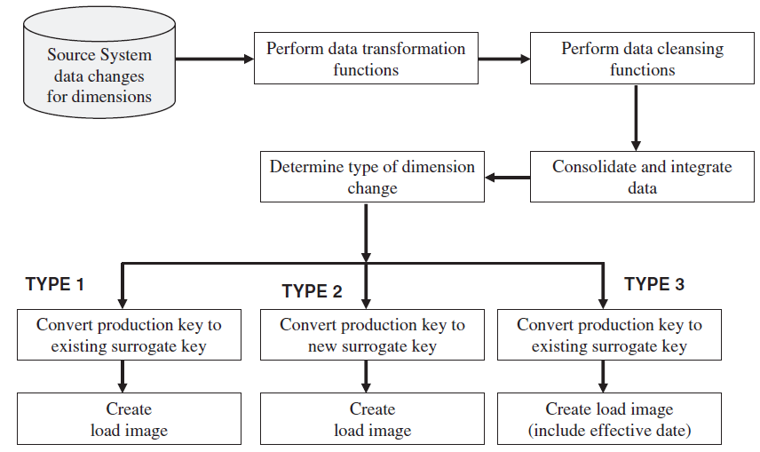
Data Transformation
Transformation for Dimension Attributes

Slide 43
Data Transformation
How to Implement Transformation?
The types of data transformation are by far more difficult and challenging.
Data transformation tools can be expensive.
Using Transformation Tools
Improves efficiency and accuracy.
You just have to specify the parameters, the data definitions, and the rules to the transformation tool.
When you specify the transformation parameters and rules, these are stored as metadata by the tool.
When changes occur to transformation functions, the metadata for the transformations get automatically adjusted by the tool.

Slide 44
Data Transformation
How to Implement Transformation?
Using Manual Techniques
Manual techniques are adequate for smaller data warehouses.
Manually coded programs and scripts perform every data transformation.
This method involves elaborate coding and testing.
Unlike automated tools, the manual method is more likely to be prone to errors.
In-house programs have to be designed differently if you need to store and use metadata.
Every time changes occur to transformation rules, the metadata has to be maintained.
This puts an additional burden on the maintenance of manually coded transformation programs

Slide 45
Data Loading

Slide 46
Data Loading
Transformation functions end as soon as load images are created.
Create load images to correspond to the target files to be loaded in the data warehouse database.
Moving data into the data warehouse repository can be done in following ways
Initial load
Populating all the data warehouse tables for the very first time
Incremental Load
Applying ongoing changes as necessary in a periodic manner.
Full Refresh
Completely erasing the contents of one or more tables and reloading with fresh data
Initial load is a refresh of all the tables

Slide 47
Data Loading
During the loads, the data warehouse has to be offline.
Need to find a window of time when the loads may be scheduled without affecting your data warehouse users.
Divide up the whole load process into smaller chunks and populating a few files at a time
You may be able to run the smaller loads in parallel.
You might be able to keep some parts of the data warehouse up and running while loading the other parts.
Provide procedures to handle the load images that do not load.
Have a plan for quality assurance of the loaded records.

Slide 48
Data Loading
Having staging area and data warehouse database on same server will save efforts.
If they are on different servers, consider the options carefully and select one wisely.
The Web, FTP, and database links are a few of the options.
You have to consider the necessary bandwidth needed and also the impact of the transmissions on the network.
How can we apply data?
By writing special load programs.
Load utilities that come with the DBMSs provide a fast method for loading.

Slide 49
Data Loading
Techniques and Processes for Applying Data
Three types of application of data to the data warehouse: initial load, incremental load, and full refresh
For the initial load
Extract the data from the various source systems,
Integrate and transform the data,
Then create load images for loading the data into the respective dimension table.
For an incremental load
Collect the changes to the product data for those product records that have changed in the source systems since the previous extract,
Run the changes through the integration and transformation process,
Create output records to be applied to the product dimension table.
A full refresh is similar to the initial load

Slide 50
Data Loading
Techniques and Processes for Applying Data
We need to create a file of data to be applied to the product dimension table in the data warehouse.
Data may be applied in the following four different modes:
Load
Append
Destructive Merge
Constructive Merge

Slide 51
Data Loading
Modes for Applying Data
Load
If the target table to be loaded already exists and data exists in the table, the load process wipes out the existing data and applies the data from the incoming file.
If the table is already empty before loading, the load process simply applies the data from the incoming file.
Before
After
Data Staging
Warehouse
Warehouse
Key
123
234
345
Data
AAAA
BBB
CCCCC
Load
Key
567
678
789
Data
XXXXX
YY
ZZZZ
Key
123
234
345
Data
AAAA
BBB
CCCCC

Slide 52
Data Loading
Modes for Applying Data
Append
If data already exists in the table, the append process unconditionally adds the incoming data, preserving the existing data in the target table.
When an incoming record is a duplicate of an already existing record, you may define how to handle an incoming duplicate.
The incoming record may be allowed to be added as a duplicate.
the incoming duplicate record may be rejected during the append process.

Slide 53
Data Loading
Modes for Applying Data
Append
Before
After
Data Staging
Warehouse
Warehouse
Key
123
234
345
Data
AAAA
BBB
CCCCC
Append
Key
111
Data
RRR
Key
111
123
234
345
Data
RRR
AAAA
BBB
CCCCC

Slide 54
Data Loading
Modes for Applying Data
Destructive Merge
If the primary key of an incoming record matches with the key of an existing record, update the matching target record.
If the incoming record is a new record without a match with any existing record, add the incoming record to the target table.
Before
After
Data Staging
Warehouse
Warehouse
Destructive Merge
Key
123
234
345
Data
AAAA
BBB
CCCCC
Key
123
Data
RRRRR
Key
123
234
345
Data
AAAA
BBB
CCCCC

Slide 55
Data Loading
Modes for Applying Data
Constructive Merge
If the primary key of an incoming record matches with the key of an existing record, leave the existing record, add the incoming record, and mark the added record as superseding the old record.
Before
After
Data Staging
Warehouse
Warehouse
Constructive Merge
Key
123
234
345
Data
AAAA
BBB
CCCCC
Key
123
Data
RRRRR
Key
123
123
234
345
Data
AAAA*
RRRRR
BBB
CCCCC

Slide 56
Data Loading
How the modes of applying data to the data warehouse fit into the three types of loads?
Initial Load
Instead of loading whole data warehouse in single run, split the load into separate sub loads and run each of these sub loads as single loads. (every load run creates the database tables from scratch)
In this way, we will be using load mode.
For the first run of the initial load of a particular table, use the load mode.
All further runs will apply the incoming data using the append mode.
Drop the indexes prior to the loads to make the loads go quicker.
Rebuild or regenerate the indexes when the loads are complete.

Slide 57
Data Loading
How the modes of applying data to the data warehouse fit into the three types of loads?
Incremental Load
These are the applications of ongoing changes from the source systems tied to specific time stamps.
In constructive merge mode, if the primary key of an incoming record matches with the key of an existing record, the existing record is left in the target table as is and the incoming record is added and marked as superseding the old record.
If the time stamp is also part of the primary key or if the time stamp is included in the comparison between the incoming and the existing records, then constructive merge may be used to preserve the periodic nature of the changes.
The change to a dimension table record is Type 1 change i.e. to correct an error in the existing record. The existing record must be replaced by the corrected incoming record, so you may use the destructive merge mode.

Slide 58
Data Loading
How the modes of applying data to the data warehouse fit into the three types of loads?
Full Refresh
Involves periodically rewriting the entire data warehouse.
You may also do partial refreshes to rewrite only specific tables.
Full refresh is similar to the initial load.
Data exists in the target tables before incoming data is applied. The existing data must be erased before applying the incoming data.
The load and append modes are applicable to full refresh.

Slide 59
Data Loading
After the initial load, you may maintain the data warehouse and keep it up to date by using two methods:
Refresh—complete reload at specified intervals.
Update—application of incremental changes in the data sources.
Refresh is a much simpler option than update
Refresh involves the periodic replacement of complete data warehouse tables.
Refresh jobs can take a long time to run.
To use the update option,
You have to devise the proper strategy to extract the changes from each data source
Then you have to determine the best strategy to apply the changes to the data warehouse.

Slide 60
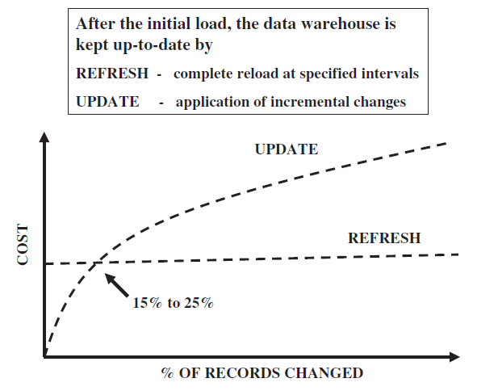
Data Loading
The cost of refresh remains constant irrespective of the number of changes in the source systems.
If the number of changes increases, the time and effort for doing a full refresh remain the same.
The cost of update varies with the number of records to be updated.

Slide 61
Data Loading
Procedure for Loading Dimension Tables
The procedure for maintaining the dimension tables includes two functions:
The initial loading of the tables;
Applying the changes on an ongoing basis.
There are two issues:
About the keys of the records in the source systems
The keys of the records in the data warehouse.
In the data warehouse, you use system generated keys.

Slide 62
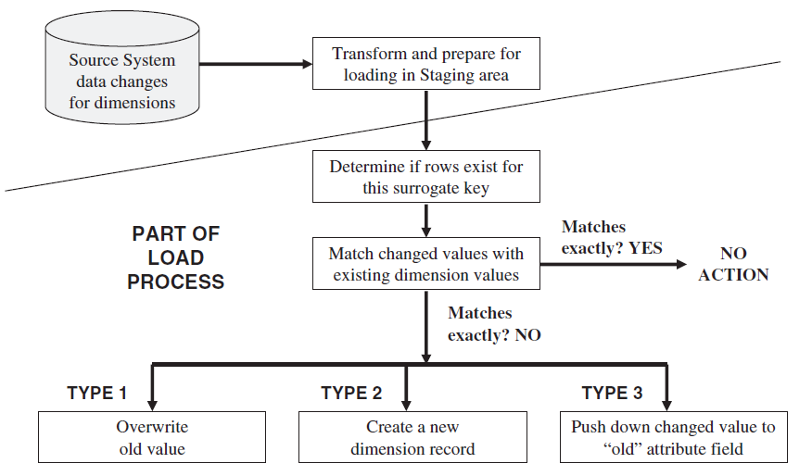
Data Loading

Slide 63
Data Loading
Procedure for Loading Fact Tables
The key of the fact table is the concatenation of the keys of the dimension tables.
Therefore, dimension records are loaded first. Then, before loading each fact table record, you have to create the concatenated key for the fact table record from the keys of the corresponding dimension records.
History Load of Fact Tables:
Identify historical data useful and interesting for the data warehouse.
Define and refine extract business rules.
Capture audit statistics to tie back to the operational systems.
Perform fact table surrogate key look-up.
Improve fact table content.
Restructure the data.
Prepare the load files.

Slide 64
Data Loading
Procedure for Loading Fact Tables
Incremental Load for Fact Tables:
Incremental extracts for fact tables
Consist of new transactions
Consist of update transactions
Use database transaction logs for data capture
Incremental loads for fact tables
Load as frequently as feasible
Use partitioned files and indexes
Apply parallel processing techniques

Slide 65
Data Replication
Data replication is simply a method for creating copies of data in a distributed environment.
The broad steps for using replication to capture changes to source data:
Identify the source system database table
Identify and define target files in the staging area
Create mapping between the source table and target files
Define the replication mode
Schedule the replication process

Slide 66
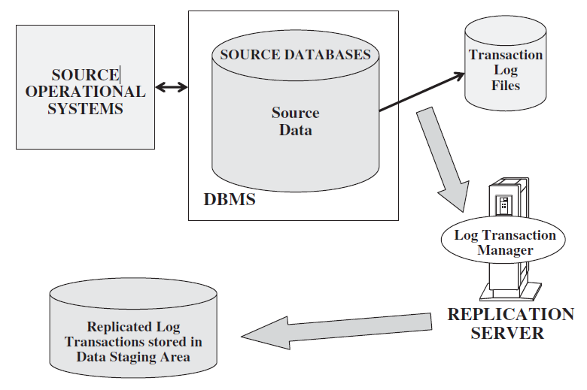
Data Replication

Slide 67
ETL Tools
ETL tools fall into the following three broad functional categories:
Data transformation engines
Captures data from a designated set of source systems at user-defined intervals, performs elaborate data transformations, sends the results to a target environment, and applies the data to target files.
Data capture through replication
The changes to the source systems captured in the transaction logs are replicated in near real time to the data staging area for further processing.
Some tools provide the ability to replicate data through the use of database triggers.
Code generators
These tools directly deal with the extraction, transformation, and loading of data.
Enable the process by generating program code to perform these functions.

